Slide 1
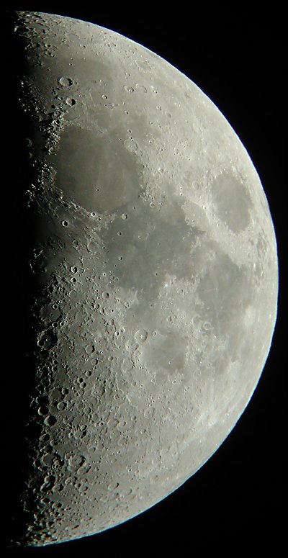
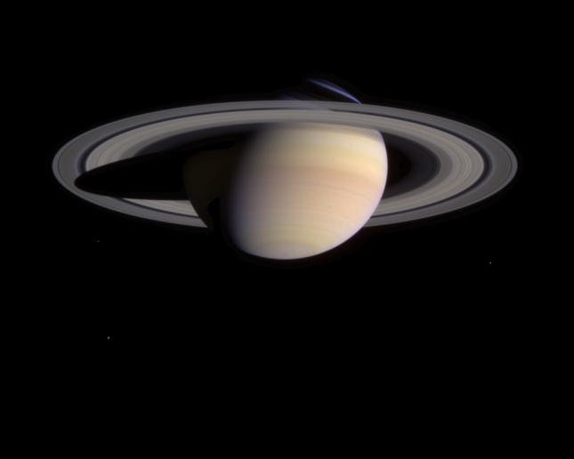
Lunar Madness & Planetary Thrills
HAL September 16, 2004
By: Richard Orr

Slide 2
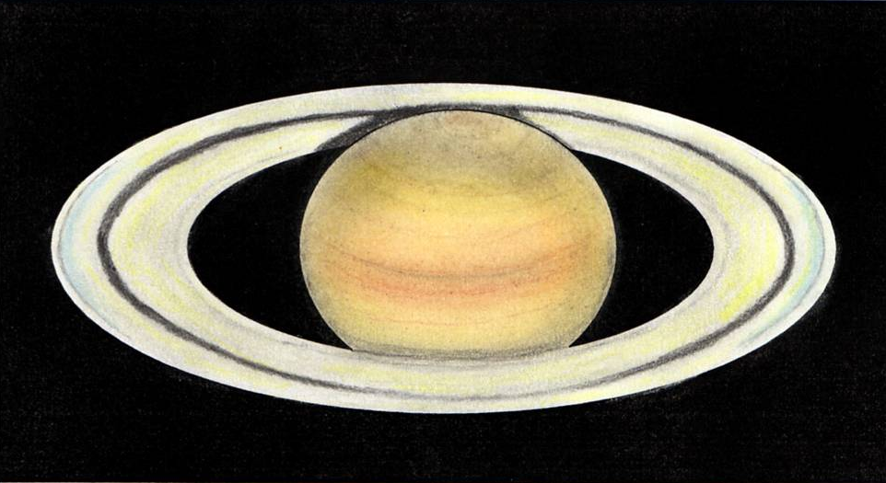

Slide 3
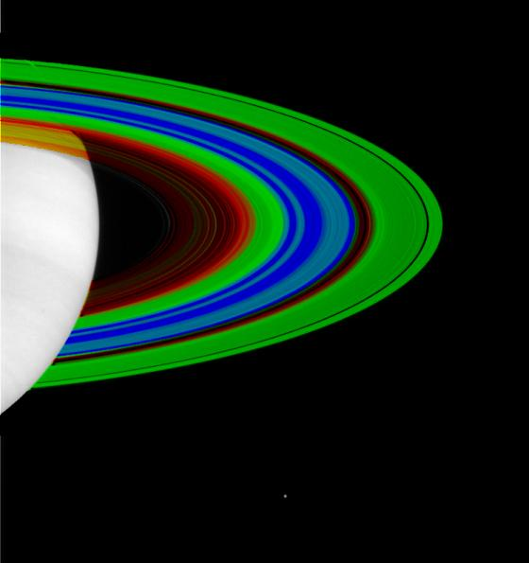
Notes:
Red represents temperatures of about 110 Kelvin (-261 degrees Fahrenheit), and blue 70 Kelvin (-333 degrees Fahrenheit). Green is equivalent to 90 Kelvin (-298 degrees Fahrenheit). Water freezes at 273 Kelvin (32 degrees Fahrenheit). The spatial resolution of the ring portion of the image is 200 kilometers (124 miles).
The data show that the opaque region of the rings, like the outer A ring (on the far right) and the middle B ring, are cooler, while more transparent sections, like the Cassini Division (in red just inside the A ring) or the inner C ring (shown in yellow and red), are relatively warmer.
The temperature data were taken on July 1, 2004, of the unlit side of the rings. In order to show the full breadth of the rings, a strip of temperature data was mapped onto a picture of the lit side of the rings taken with the Cassini narrow angle camera on May 11, 2004, a little over a month before Saturn orbit insertion. Cassini is too close to the planet and hence no pictures of the unlit side of the rings are available, so the temperature data were mapped onto a picture of the lit side of rings. Saturn is overexposed and pure white in this picture. Saturn's moon Enceladus is visible below the rings

Slide 4
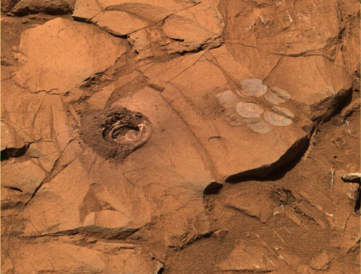
Notes:
Spirit & Opportunity still going strong on Mars

Slide 5
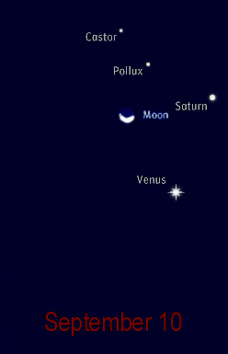
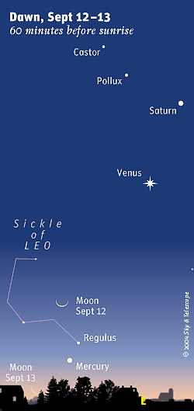
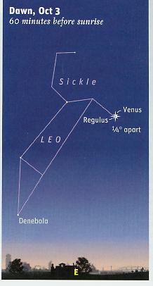

Slide 6
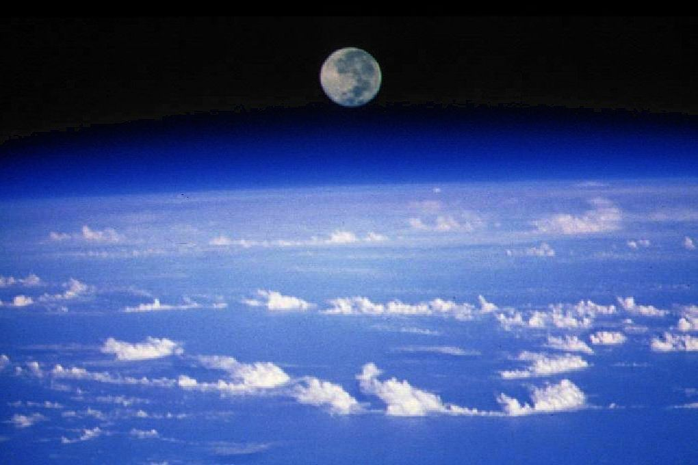
Notes:
When dinosaurs roamed the Moon’s death’s head sockets wore the same expression as now.
The Pythagoreans (around 500 BC) – followeres of Pythagoras of Samos – taught that the large naked-eye spots in the Moon were relections of the Earth’s continents and seas in its mirror-like surface.
One Arab mapmaker to outline the unknown coasts of Africa from the lunar disk
Kepler’s patron the Holy Roman Emperor Rudolf II emagined he could see Italy and the its two adjacect islands distinctly outlined at full moon.
Leonardo – If you keep the details of the spots of the Moon under observation you will often find great variation in them, and this I myself have proved by drawing them. And this is caused by clouds that rise from the waters in the Moon, which come between the Sun and those waters, and by their shadow deprive these waers of the Sun’s rays”
Herschel “It has hitherto been supposed that those seas, as they are called, consisted of a different kind of soil which reflected light less copiously than the Hills and Mountains. I conclude them to be Woods or Forests…these Forests…cast shadows all along the side opposite the Sun. Now I think if we admit this dark coloured ground to be forests it will solve all these appearances at once; which in other Hypotheses will be found very difficult” Craters were circuses (several streets come together) – and he pondered tht perhaps on the moon every town is one very large circus. He recorded a a city directly (new spot) – he will not be the last. It is likely that one of his main goals for creating larger telescopes was to prove the presence of intelligent beings.
Unchanging but never the same. Saros cycle every 18 years.

Slide 7
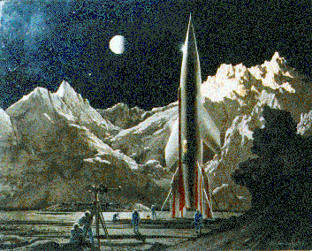
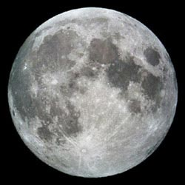
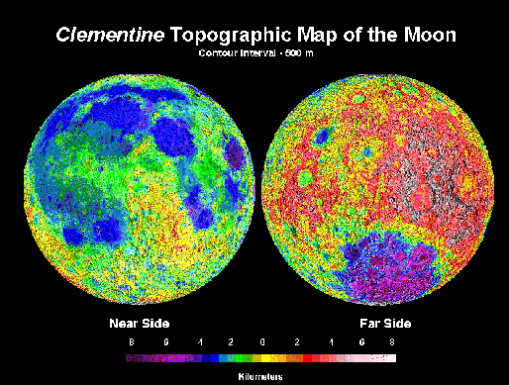

Slide 8
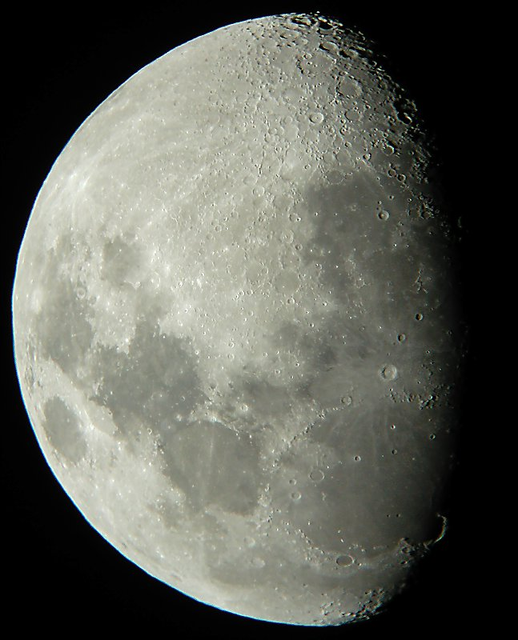
Live Fast -- Die Young
The moon is 4.5 billion years old and was formed when a Mars sized planet collided with a 50 million year old earth
The highlands (areas that are not dark) are covered with impact craters which occurred mostly between 4.5 and 3.0 billion years ago
The dark areas are huge impact basins from asteroid-sized collisions – the last occurred 3.5 billion years ago
These different areas were capped at different times with basaltic rock; but this ended 3 billion years ago
Little has changed in 3 billion years and is geologically inactive

Slide 9
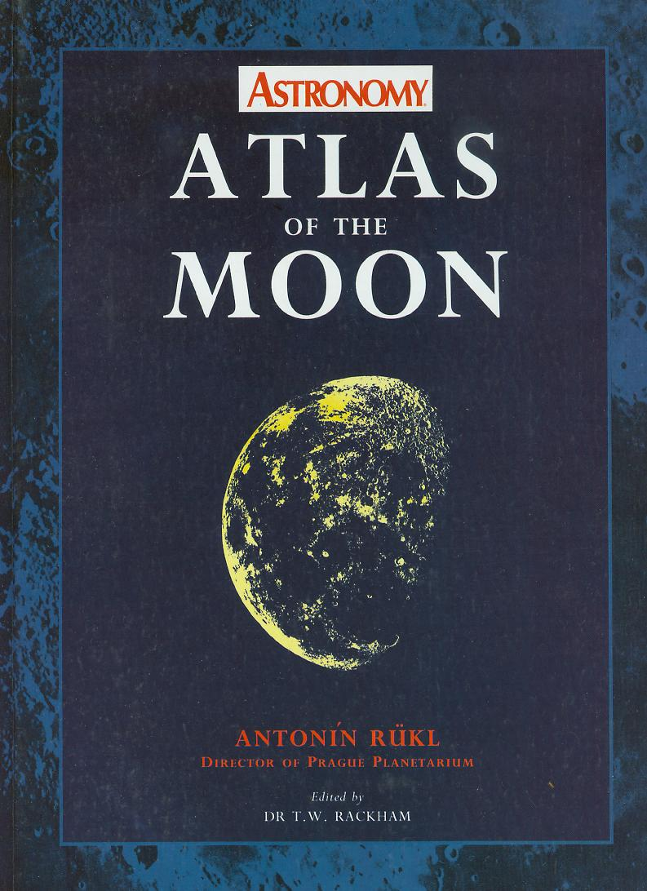
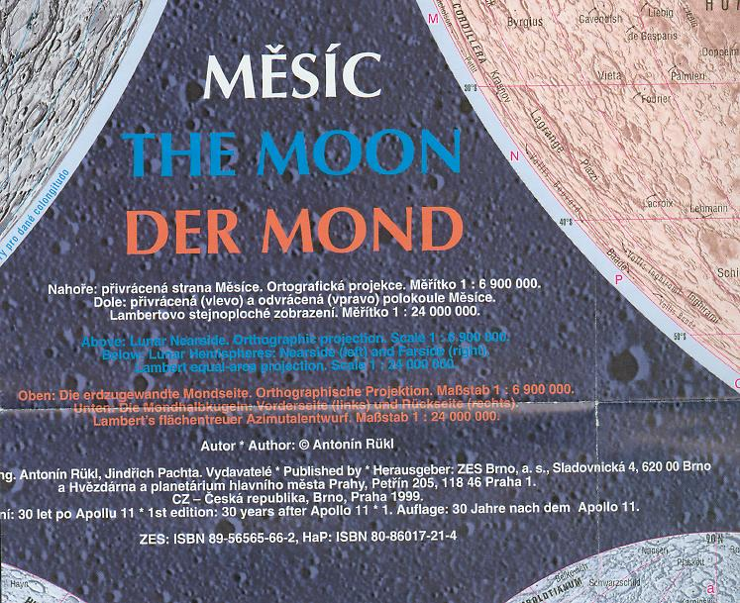

Slide 10
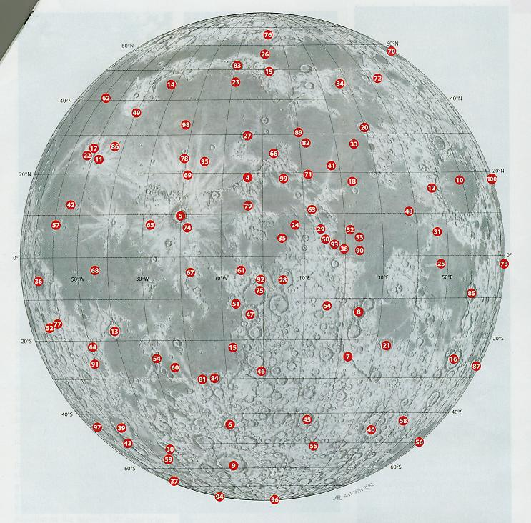
INTRODUCING THE LUNAR 100 By Charles A. Wood April 2004 – S &T
Notes:
April 2004

Slide 11
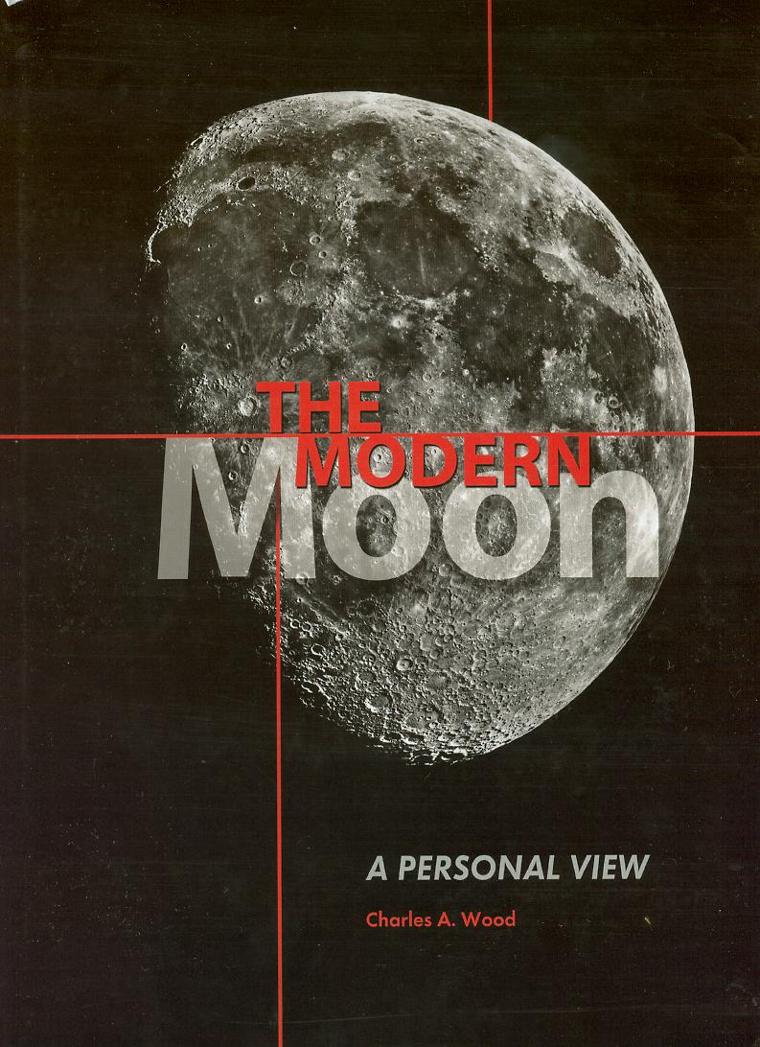
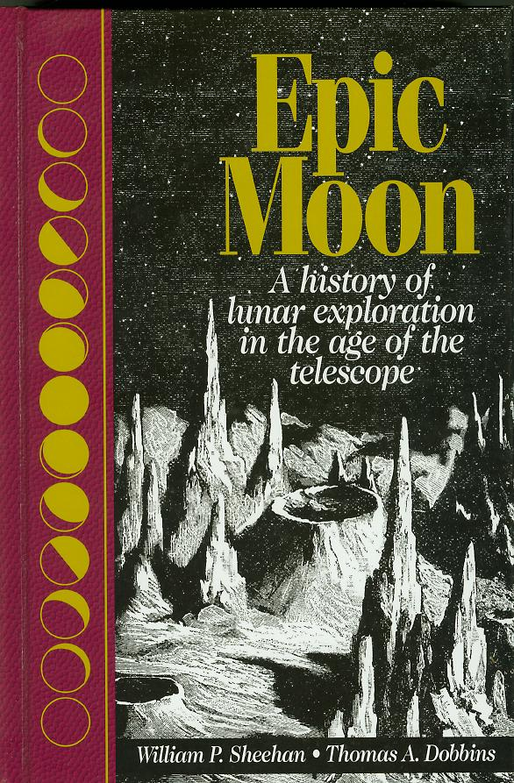

Slide 12
